Slide 1
Project Presentation On Online Ticket Booking System
Nayeem Solmani Chaudhury
CSE 35th (A)
ID: 151-115-032

Slide 2
Tools and Technology:
HTML, CSS, Bootstrap, JavaScript, Laravel
Features:
1. User Can Create Account.
2. Only Authenticated user can Book Tickets.
3. Users can Book Bus/Train /Flight Tickets.
4. Only Admin can Create, Update, Delete Posts.

Slide 3
Why I Developed this project:
In our daily life we have to book tickets for bus, train or flight. When we do this task manually then it becomes very hard to manage the ticket booking. So, I have developed a system that can manage booking of tickets. In this online web application project, i have developed the system that can help user to book their ticket online. When someone start their travelling tour they have to book ticket, so we help them from the starting point to the end.

Slide 4
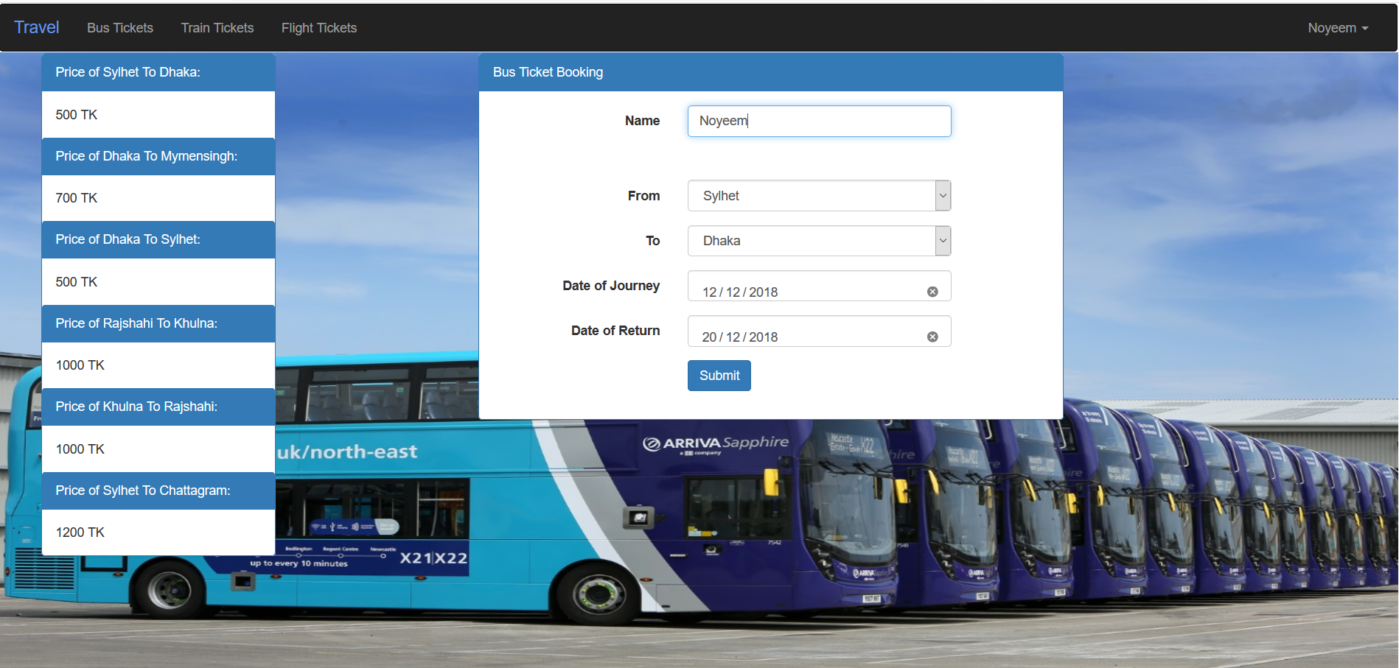
This is the Home page, Where authenticated user can book tickets of Bus, Train or Flight .

Slide 5
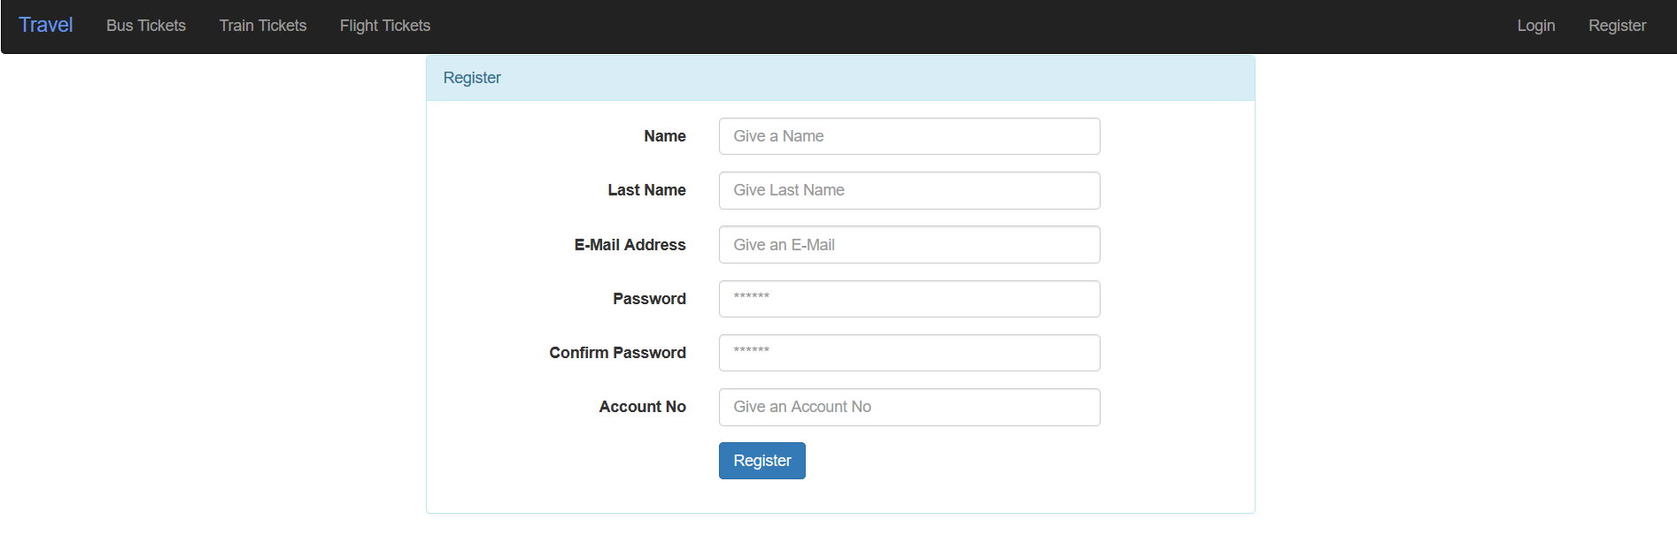
This is Register page. Users must be Authenticated in order to book tickets and must give valid information about them.

Slide 6
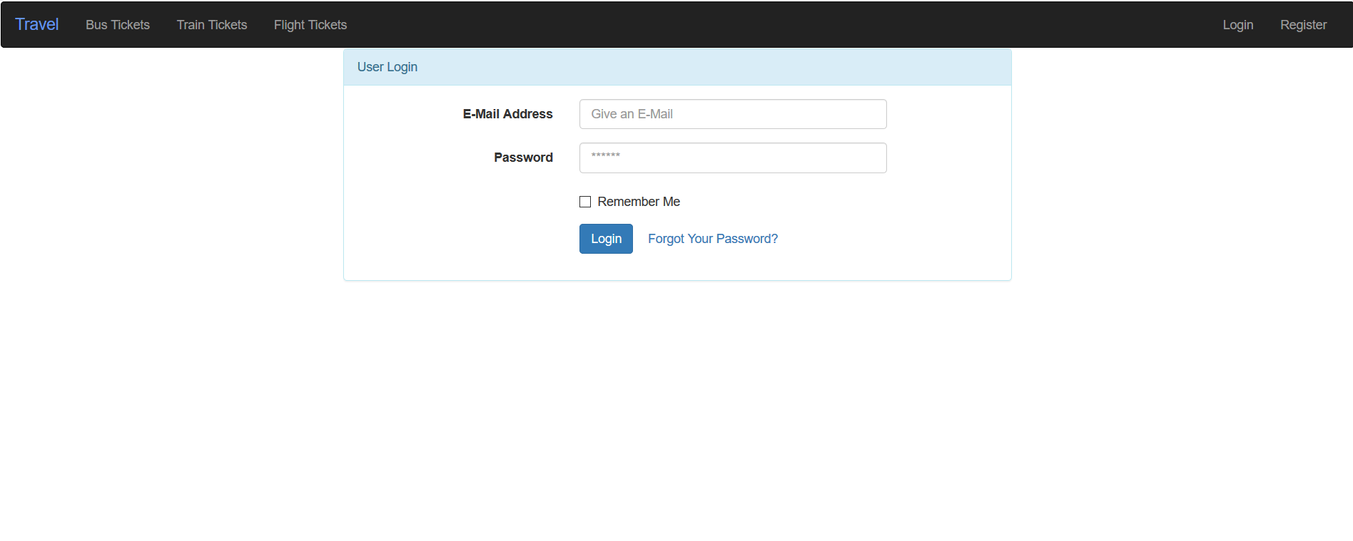
This is the Login Page. A registered user can Log in and book tickets.

Slide 7
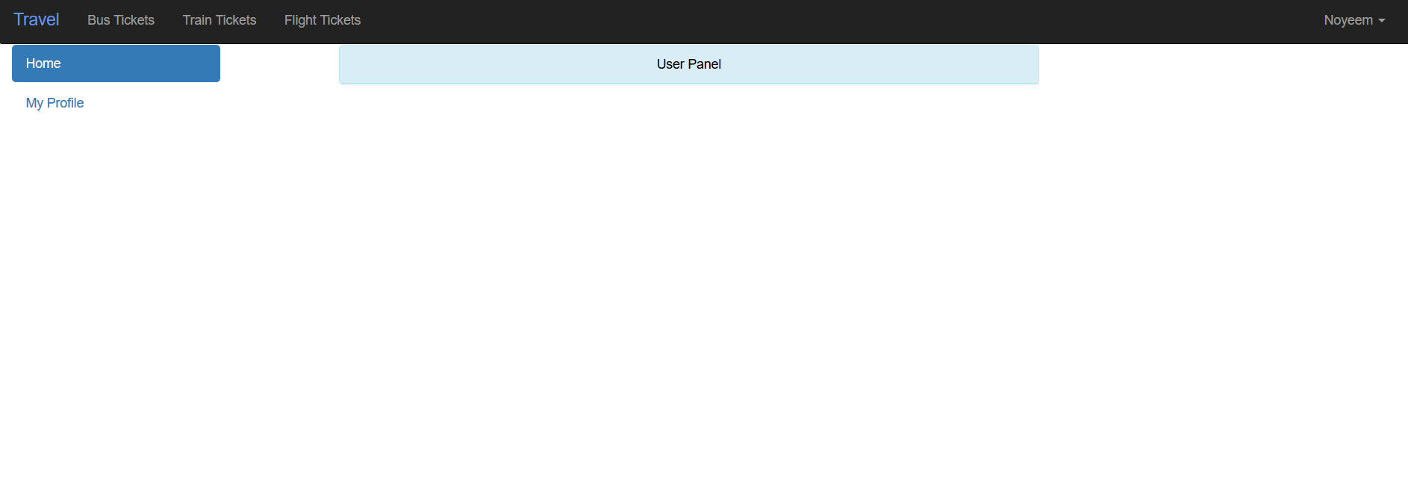
This is the User Panel.

Slide 8
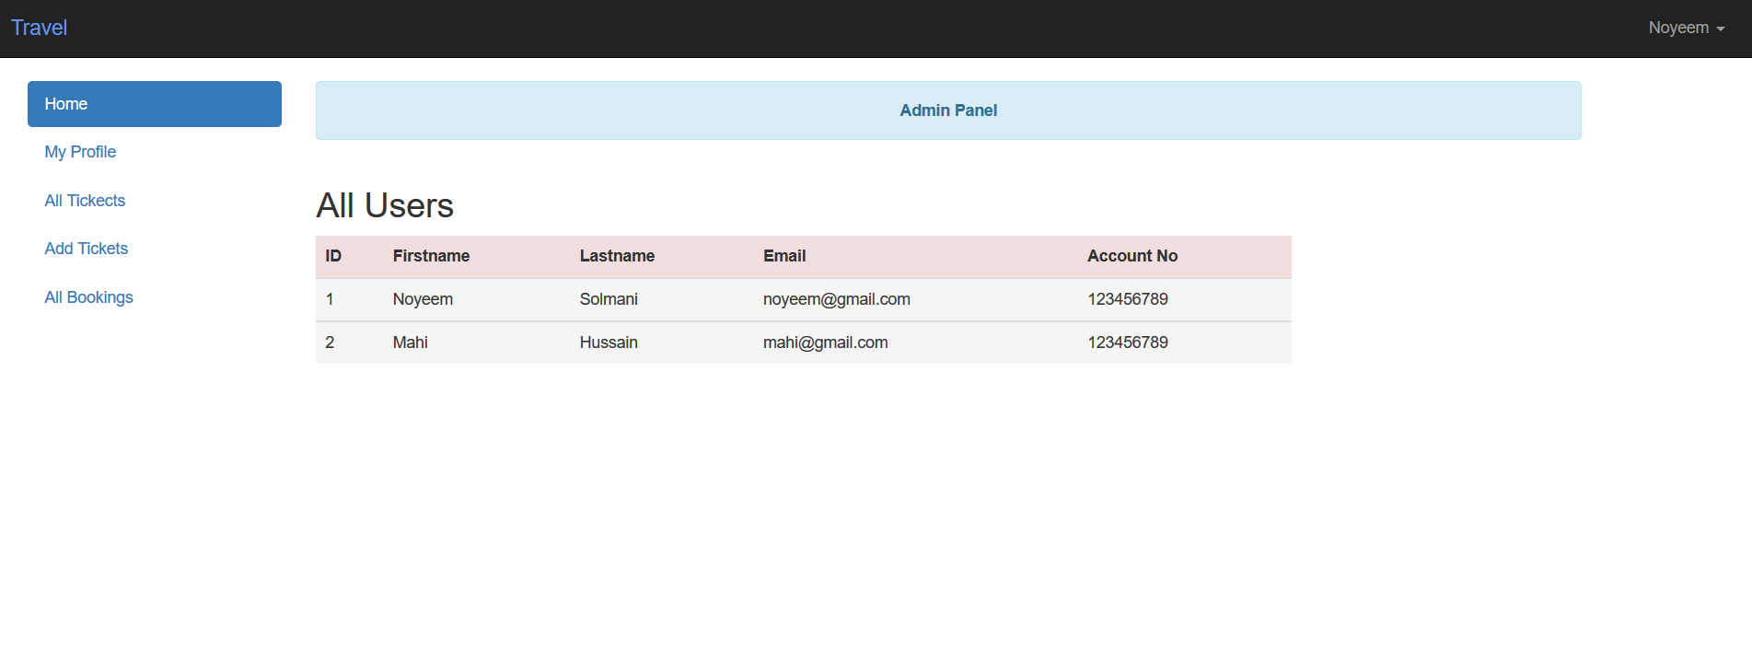
This is the home page of Admin. Admin can see the users information and their bookings.

Slide 9
1) if want to travel anywhere, we need bus, train or flights. This project will eliminate the hassle of long queue. 2) The users get to do the entire booking of their buses, train & flight tickets from the comfort of their home.
Advantages of my project:

Slide 10
https://www.w3schools.com/ https://stackoverflow.com/ https://www.biman-airlines.com/ https://www.shohoz.com/ http://busbd.com.bd/ https://www.esheba.cnsbd.com/ https://www.google.com/
Some Website That Follow:

Slide 11
Thank You Everyone

